Slide 1
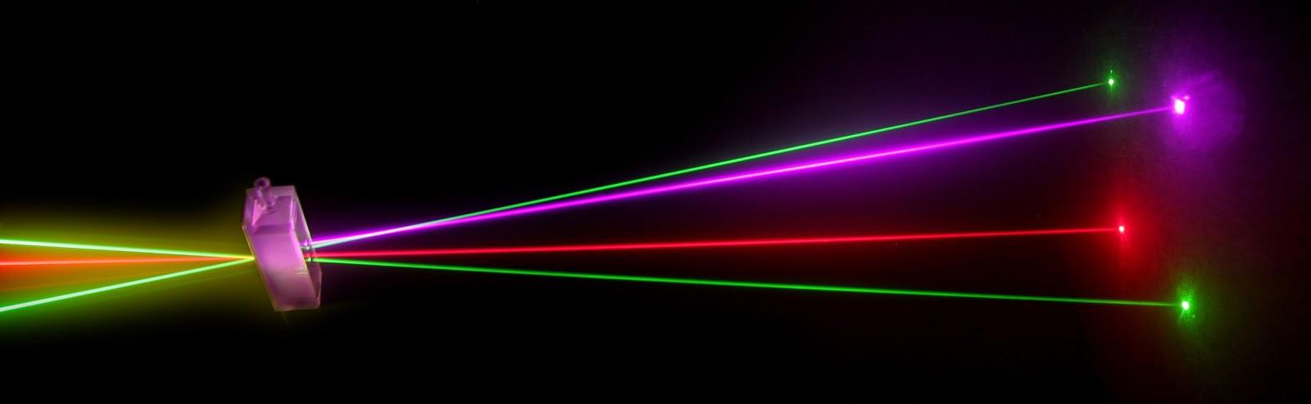
“Laser Technology and Applications” 16B1NPH533 Lecture 27-28

Slide 2
Lecture 27-28 Content Outlines
GENERATION OF HIGH POWER PULSES
Mode Locking –Theory and techniques

Slide 3
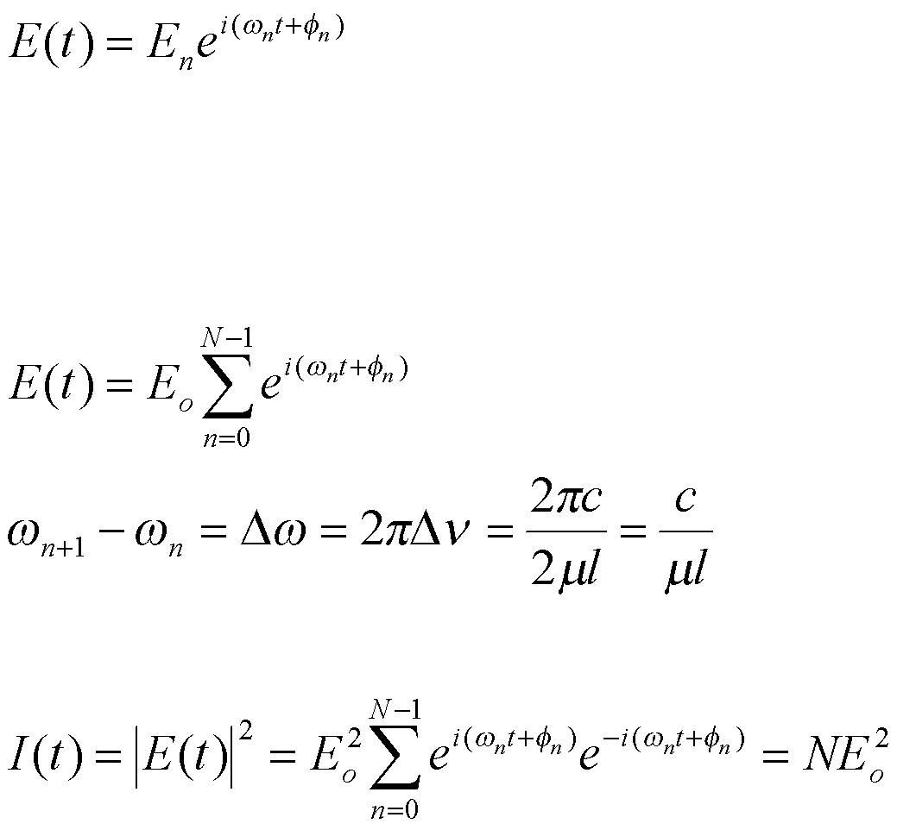
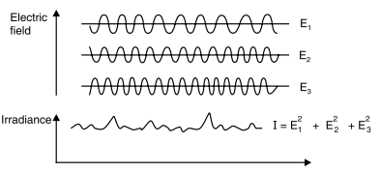
Mode Locking
When modes of electromagnetic waves of different frequencies but with random phases are added, they produce a randomly distributed, average output of both the electric field and the intensity in the time domain.
where ω_{n} is the frequency and φ_{n} is the phase of that mode. Assume that there are N modes of equal amplitude oscillating simultaneously in the cavity. The combined total amplitude of all of the modes can then be expressed as
the difference in angular frequency between the modes is given as
Because these modes are oscillating in a random fashion, the total intensity is given by the absolute square of the total amplitude:
Thus, the intensity is equal to N times the intensity of the individual modes, which is not an unexpected result. This value can occasionally vary if a few modes randomly phase together, but for large TV it does not vary significantly from the average value.

Slide 4
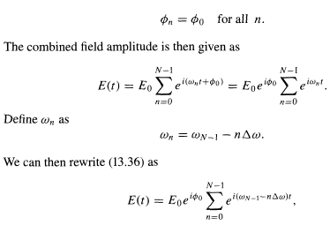
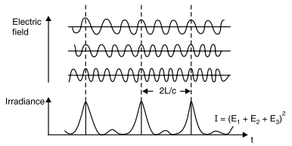
When the frequencies (modes) are added in phase - in other words, when all of their phases are zero at the same spatial location ,they combine to produce a total field amplitude and intensity output that has a characteristic repetitive pulsed nature. Hence, achieving such phasing or mode-locking has become a powerful method for generating ultrashort pulses.
Let us now examine what would happen if we could make all the modes oscillate in phase; in other words, we lock all of the modes together. Not surprisingly, this technique is known as mode-locking. This effect can be expressed as
ω _{n}= ω - n Δω
i(ω - n Δω)t

Slide 5
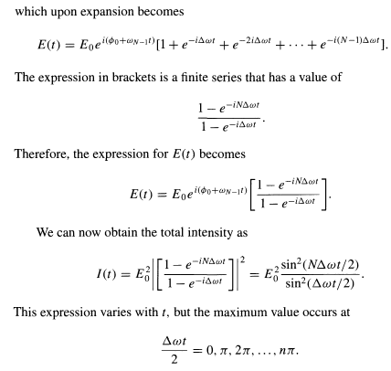

Slide 6
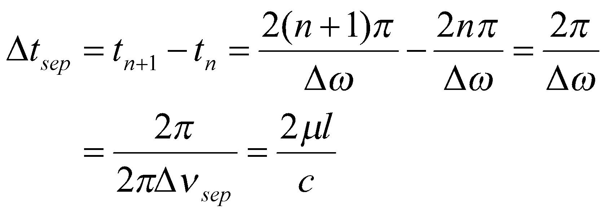

Solving for t and taking the difference between two successive maxima at t_{n+1} and
t_{n}, we have pulses at intervals Δt of
which is just the time it takes a pulse to make one round trip through the cavity. The maximum value for I(t) can be determined by evaluating the function at any of the specific values since the maximum is the same for all of those values. We will therefore choose to evaluate it at ωt/2 =0 (the simplest case) by taking the limit for I(t) as ωt/2 approaches zero:
The maximum value I(t)_{max} is therefore given by
Hence I(t)_{max} is increased by a factor of N when the modes are in phase.

Slide 7
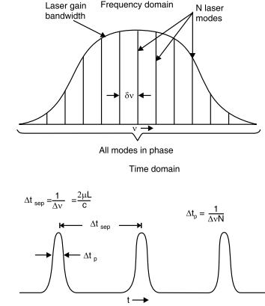
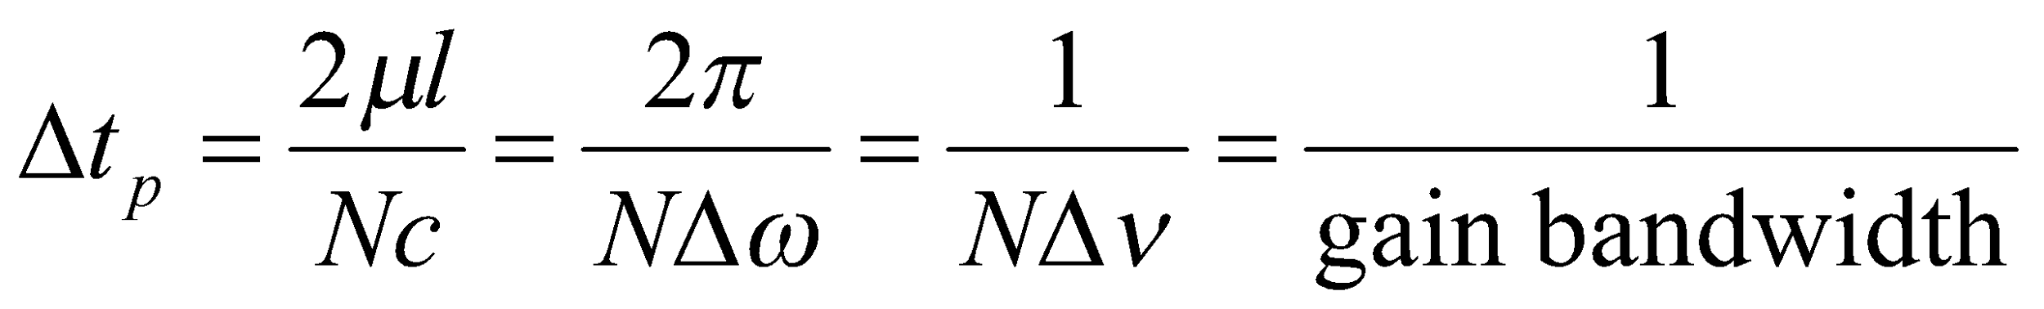
As shown in Figure, the pulses described are separated in time by Δt_{sep}= 2μl/c ,and they have a pulse width FWHM) of Δt_{p} =2μl/Nc .
As μl/c = n/Δω and hence the expression for the pulse width as
We can see that the predicted pulse width of each mode-locked pulse can be as short as the reciprocal of the N and width of the emission line, which is just NΔν.
When such a pulse width is achieved experimentally it is referred to as a bandwidth limited pulse.

Slide 8
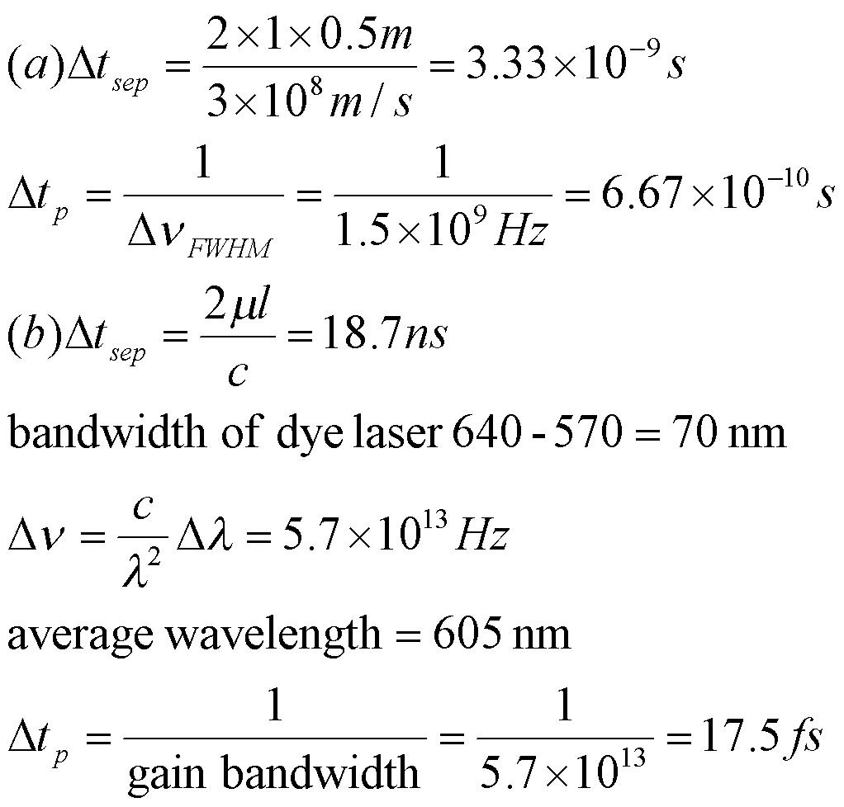
Compute the mode-locked pulse width Δt_{p} and the separation between pulses Δt_{sep} for the following mode-locked lasers.
A helium-neon laser operating at 632.8 nm with a mirror cavity spacing of l= 0.5 m. FWHM of the laser is 1.5 GHz
A Rh6G dye laser operating over its entire gain bandwidth (570-640 nm) with the cavity mirrors separated by 2 m. The index of refraction of a laser dye in typical solvent is approximately 1.4.

Slide 9
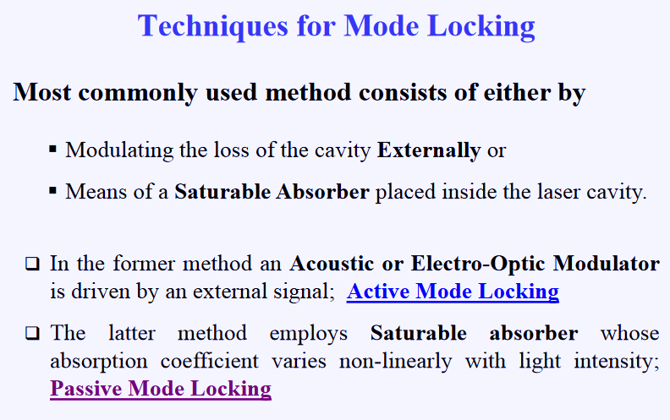

Slide 10
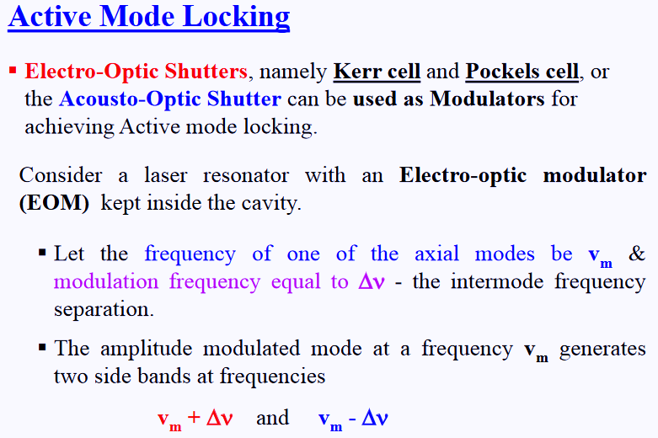

Slide 11
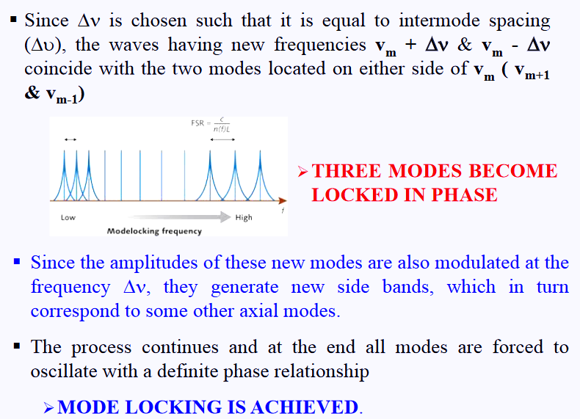

Slide 12
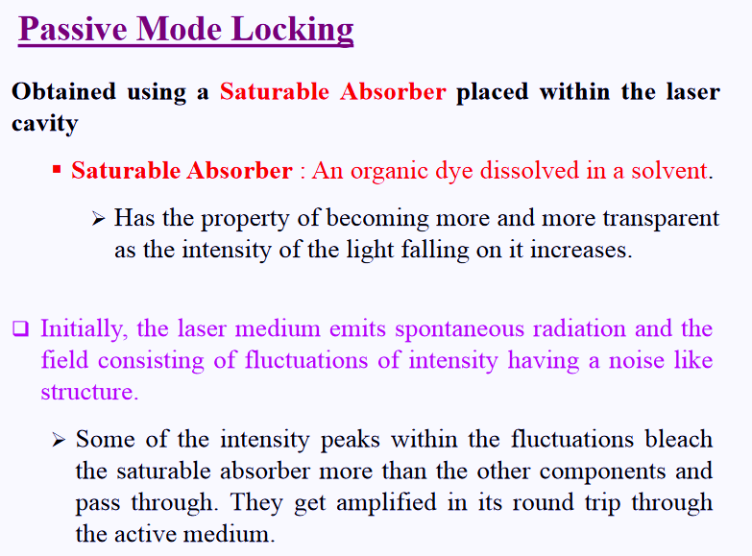

Slide 13
